Slide 1

LaGuardia Community College
Data Analytics Academy
Capstone Project – Layoffs in US
David Pilli
06.02.2025
Notes:
Intention is to get the market trends and analyze the layoffs.

Slide 2
Capstone Project Overview
To Predict Future Job Market trends.
This project analyzes layoffs across industries in the U.S.
Used a Dataset from Kaggle.
Dataset Source: https://www.kaggle.com/datasets/salimwid/layoffs-2022
Dataset Insights
Dataset Contains 9 Columns and 489 Rows
13 months data from January ‘22 to January ‘23

Slide 3
Methodologies: Imports & Data Prep
Imported necessary Python libraries like pandas, matplotlib, seaborn, etc. to process data and visualize trends.
Tableau for Visualization
Loaded the csv file into a Pandas DataFrame for analysis.
Cleaned missing and non-numeric values from key columns and grouped data by industry.

Slide 4
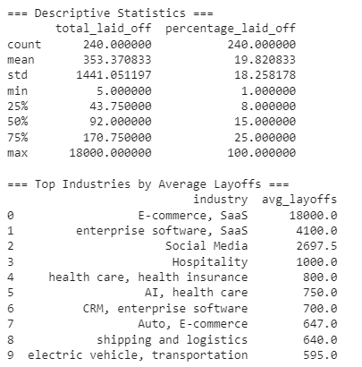
Statistical Analysis
Generated descriptive statistics and identified top industries by average layoffs.

Slide 5
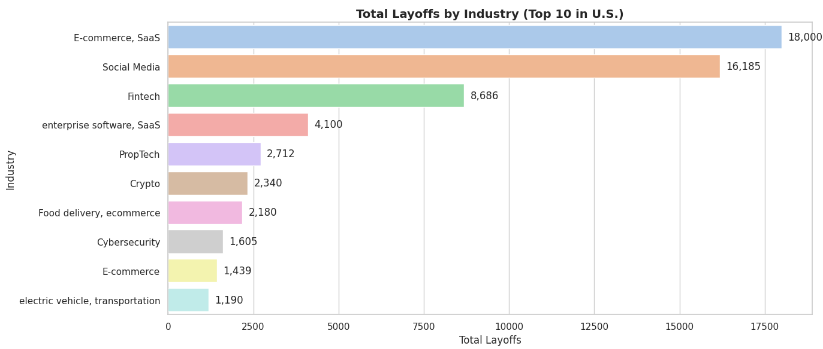
Visualization: Layoffs by Industry
Created a bar chart showing total layoffs for the top 10 industries.

Slide 6
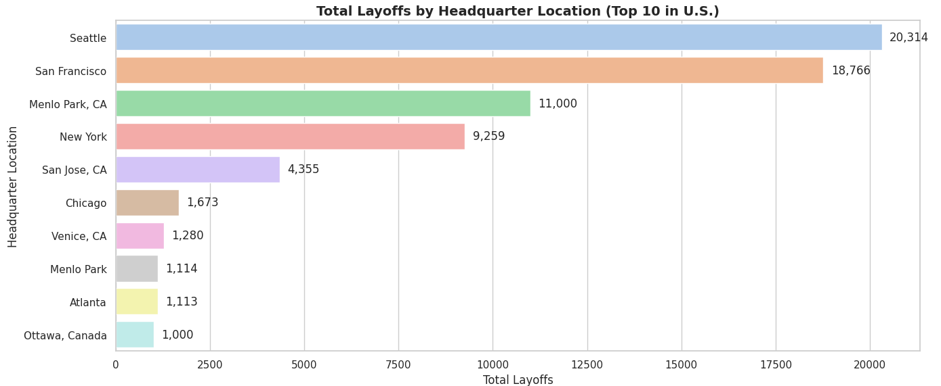
Visualization: Layoffs by Location
Created a bar chart showing total layoffs by top 10 headquarter locations.

Slide 7
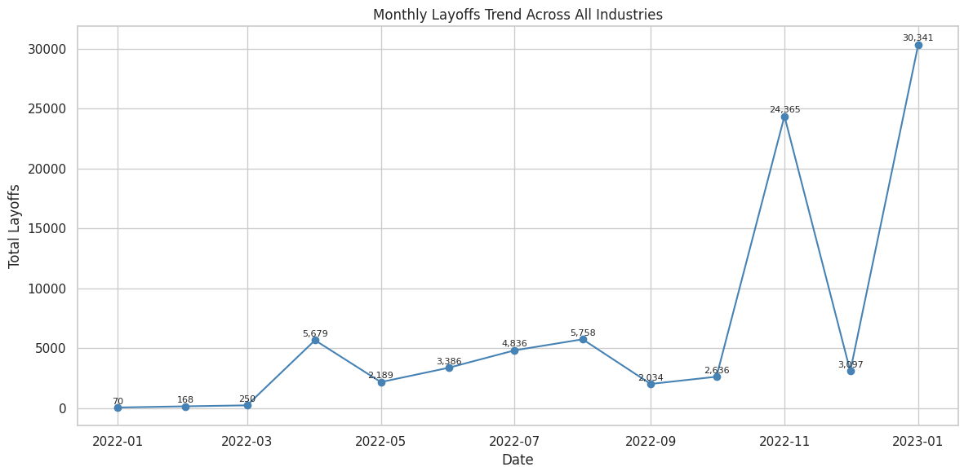
Time Series: Layoffs Over Time
Plotted total layoffs by month to identify trends across all industries.

Slide 8
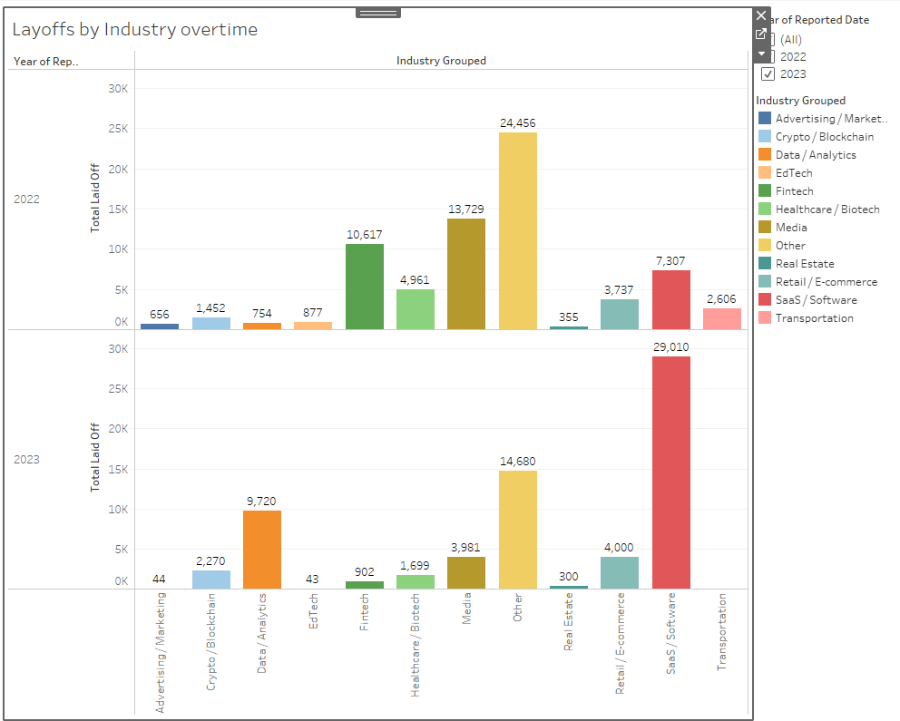
Time Series: Tableau Dashboard

Slide 9
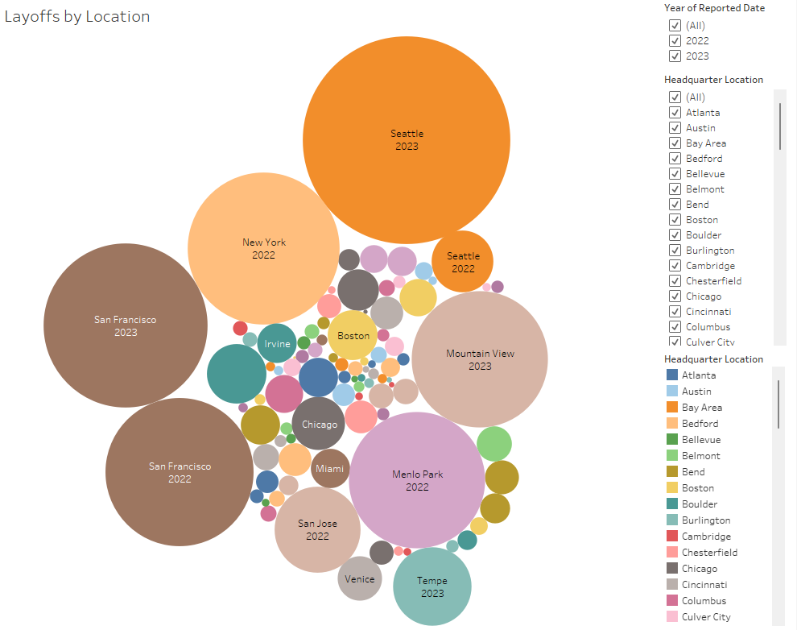
Layoffs by Location: Tableau Dashboard

Slide 10
Conclusion
The tech industry experienced the highest layoffs. These trends help understand industry stability and job market shifts.
E-Commerce and Saas are the most affected Industries with 18000 layoffs
Seattle has more layoffs across all industries – 20314
January 2023 is the most affected month where there were 30341 layoffs across all industries.
Since there is lack of data, predicting the Job market trend is difficult.
Next Steps
Get the data from WARN (Worker adjustment and retraining notification) Database and more insights

Slide 11
Thank You!

